Slide 1
Mushroom Classification with Machine Learning
Adam Sansone
UIN 676475522

Slide 2
Overview
Project Description
Data Exploration and Preprocessing
Training the Models
Results

Slide 3
Purpose
The purpose of this project is to classify mushrooms as either edible or poisonous based on the various characteristics of each mushroom sample.

Slide 4
Data Exploration and Preprocessing
The dataset was obtained from Kaggle.com. Kaggle received it from a donation by the UCI Machine Learning repository.
This dataset includes descriptions of hypothetical samples corresponding to 23 species of gilled mushrooms in the Agaricus and Lepiota Family Mushroom drawn from The Audobon Society Field Guide to North American Mushrooms (1981).
The of 8124 observations. All the variables are categorical. Each variable is comprised of different letters representing a shortened version of the feature name. The class variable consists of 2 levels, e = edible and p = poisonous.
The variable stalk.root contains 2480 “?” indicating a missing value.

Slide 5
Data Exploration and Preprocessing
The full list of variables include:
cap-shape, cap-surface, cap-color
bruises
odor
gill-attachment, gill-spacing, gill-size, gill-color
stalk-shape, stalk-root, stalk-surface-above-ring, stalk-surface-below-ring, stalk-color-above-ring, stalk-color-below-ring
veil-type, veil-color
ring-number, ring-type,
spore-print-color
Population
habitat

Slide 6
Data Exploration and Preprocessing
The Veil Type variable only had a single level and was removed form the dataset. The Veil Color and Gill Attachment variables were also removed because 95% of the data was in a single level for both edible and poisonous mushrooms.
Several levels were combined in the following variables since they were not found to be of significance alone.
Stalk Surface Above Ring, Stalk Surface Below Ring, Stalk Color Above Ring, Stalk Color Below Ring, Ring Type, Spore Print Color.
Side-by-side bar graphs and chi-squared tests were used to visualize the relationships with the class variable. The variables found to be most important to the classifying model are displayed in the next slides.

Slide 7
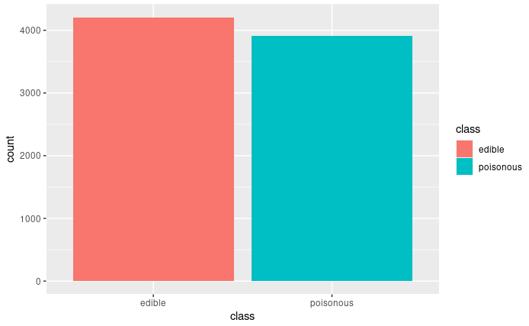

Data Exploration and Preprocessing
The class variable is very close to having a perfect split.

Slide 8
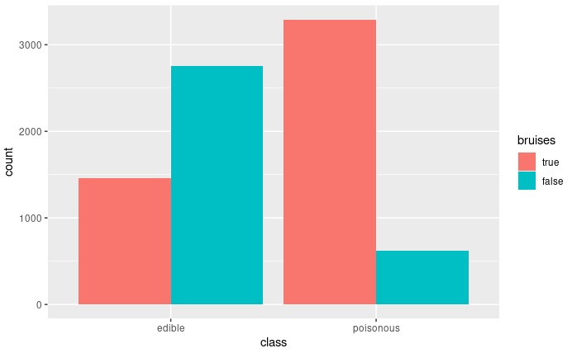

Data Exploration and Preprocessing
Bruises
Looking at the graph it appears poisonous mushrooms have bruising far more than edible mushrooms have.

Slide 9
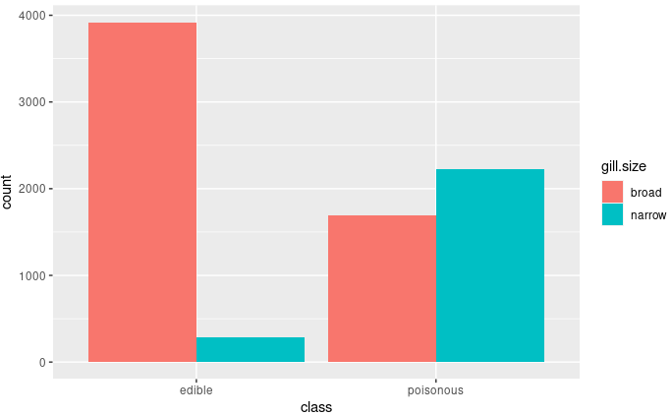

Data Exploration and Preprocessing
Gill Size
As we can see by the graph edible mushrooms almost have only gill sizes of broad, while poisonous are split.

Slide 10
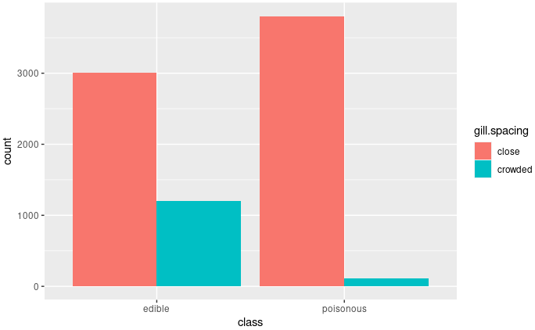

Data Exploration and Preprocessing
Gill Spacing
The Gill Spacing graph shows us that most poisonous mushrooms have close gills while almost no crowded gills.

Slide 11
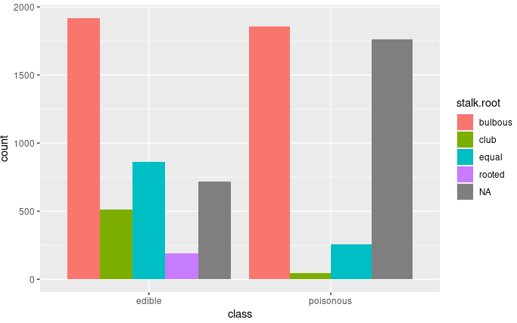

Data Exploration and Preprocessing
Stalk Root
As we can see this is the variable that contains quite a lot of missing data. We will utilize the MICE library in R to impute the missing data. Regardless we can see by the graph that poisonous mushrooms don’t contain any rooted stalks which could be a great detector of an edible mushroom.

Slide 12
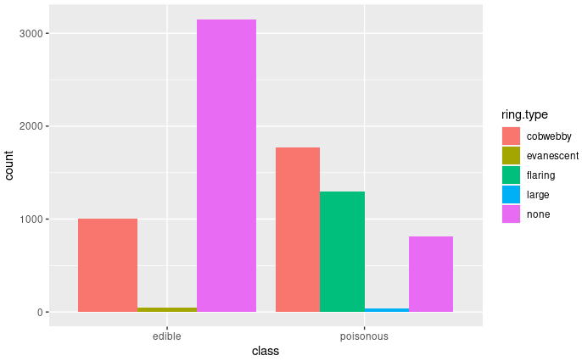

Data Exploration and Preprocessing
Ring Type
As we can see by the graph poisonous mushrooms have flaring ring types while edible mushrooms don’t have any. This will be a great indicator of a poisonous mushroom.

Slide 13
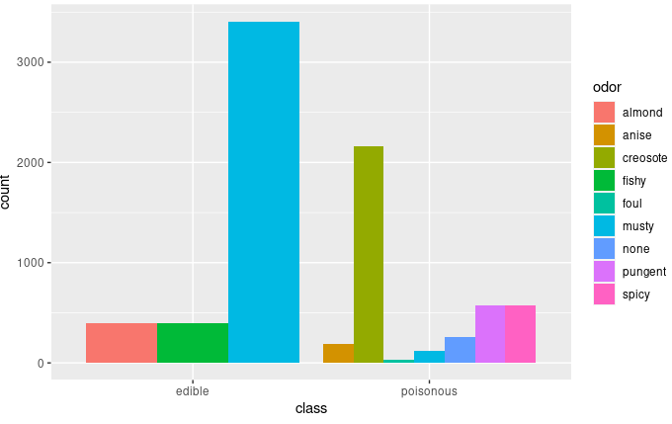

Data Exploration and Preprocessing
Odor
The graph shows us that most of the poisonous mushrooms have a creosote odor while edible have a musty odor to them.

Slide 14
Data Exploration and Preprocessing
Splitting the dataset
The dataset was split using caret into an 80% training set and a 20% test set.
10-fold cross validation was used on every model except the neural network.
The following machine learning models were used:
Naive Bayes
C5.0
Bagged CART
Random Forest
Ada Boost
Gradient Boost
Neural Network

Slide 15
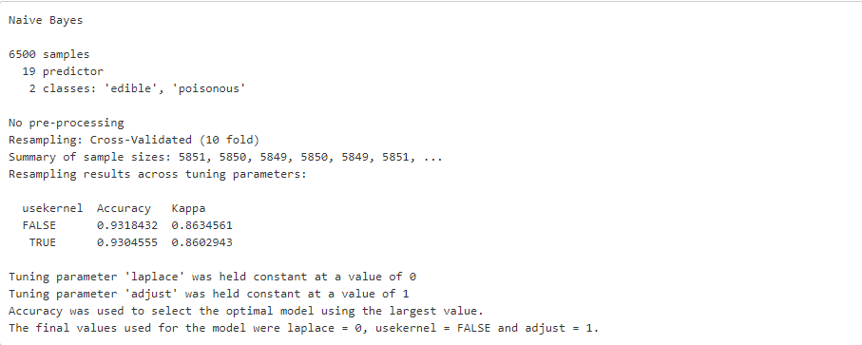
Training the Models on the Data
Naïve Bayes
The model was tuned automatically by caret, which used a laplace = 0, userkernel = FALSE, and adjust = 1.
The model got a slightly higher Accuracy without using the kernel of 93.18%. Which is not bad but let’s see how it does with the predictions.

Slide 16
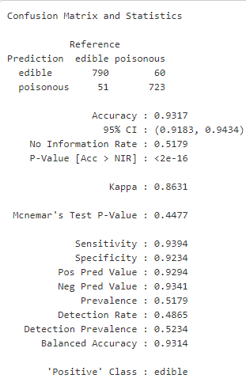
Training the Models on the Data
As we can see it, although it returned an 93% accuracy it has a lot of false positives and false negatives. The false negatives are particularly bad because of the consequences of ingesting a poisonous mushroom.

Slide 17
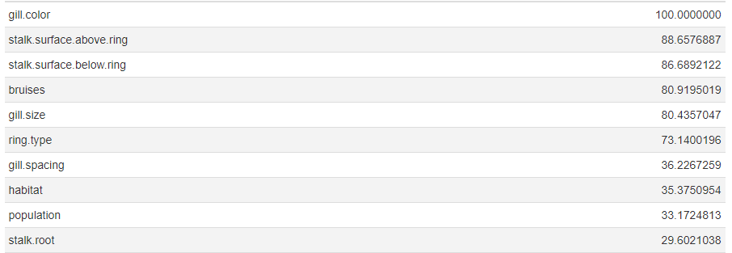
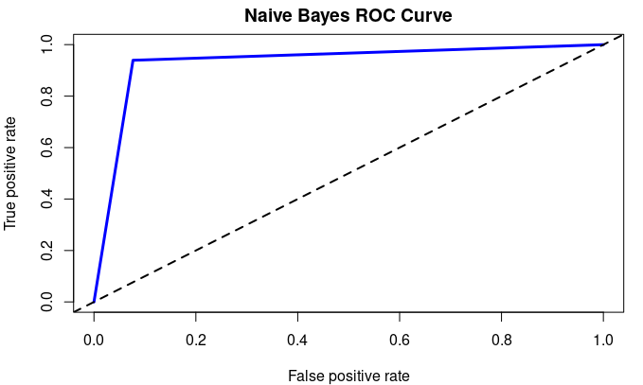
Training the Models on the Data
The top ten variables the Naïve Bayes model found important.

Slide 18
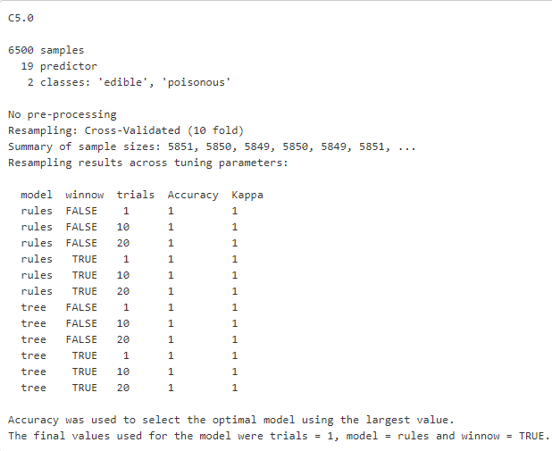
Training the Models on the Data
C5.0
The C5.0 model shows perfect accuracy. Using automatic tuning resulted in only a single trial, model = rules, and winnow = TRUE. It seemed to pick the first one due to being computationally better than the others since every different run resulted in the same results.

Slide 19
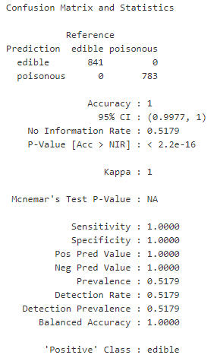
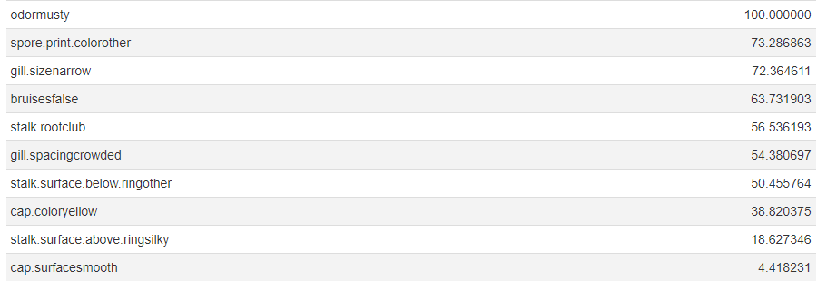
Training the Models on the Data
The model perfectly predicted the classifier and unlike the Naïve Bayes model had no false positives or false negatives.
Below are the variables the model found to be most important.

Slide 20
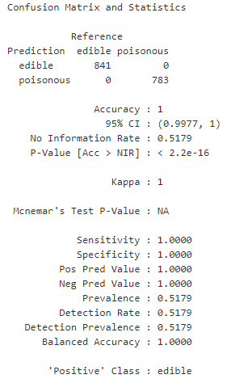
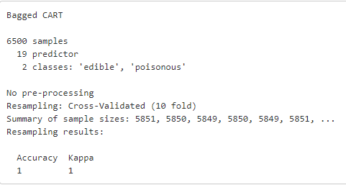
Training the Models on the Data
Bagged CART
Bagged CART also returned an accuracy of 1. With 0 false positives and 0 false negatives.

Slide 21
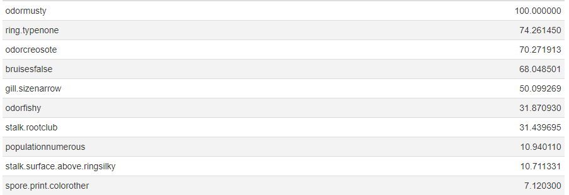
Training the Models on the Data
The important variables of this model, Odor-musty and Bruises-false, also appeared in the top 5 of the C5.0 model.

Slide 22
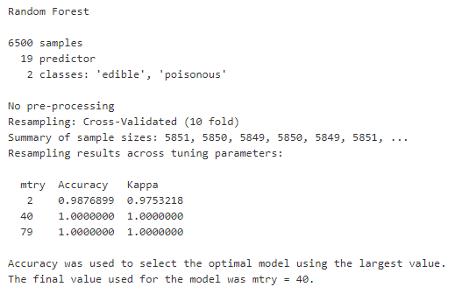
Training the Models on the Data
Random Forest
Using automatic tuning mtry = 40 was selected which resulted in perfect accuracy.

Slide 23
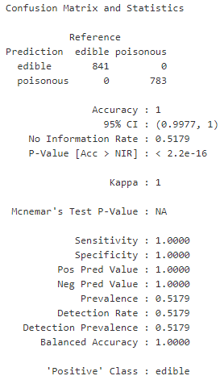
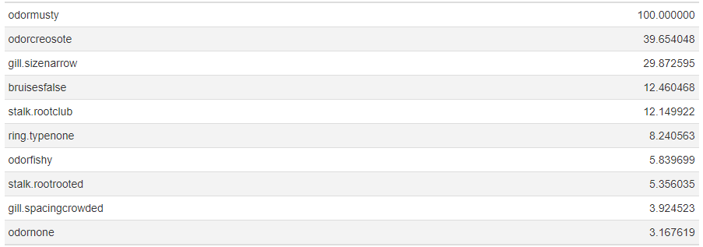
Training the Models on the Data
Another perfect classification. Again, we are seeing a repeat of variables that are being used and marked as important. With Odor being the most important.

Slide 24
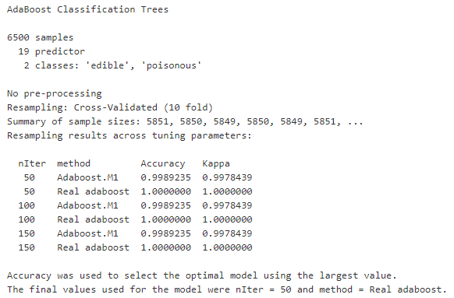
Training the Models on the Data
Ada Boosting
The model was autotuned using nIter = 50, and method = Real adaboost.

Slide 25
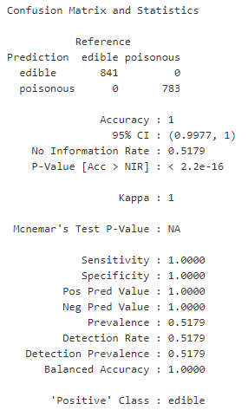
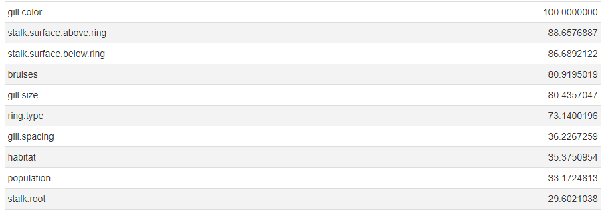
Training the Models on the Data
This model found Gill Color to be most important with the Stalk Surface, Bruising, and Gill Size close behind. Funny enough Odor doesn’t show up in the top ten.

Slide 26
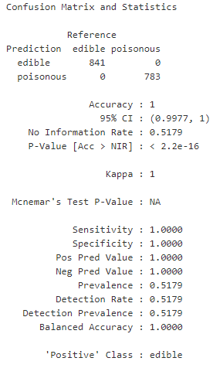
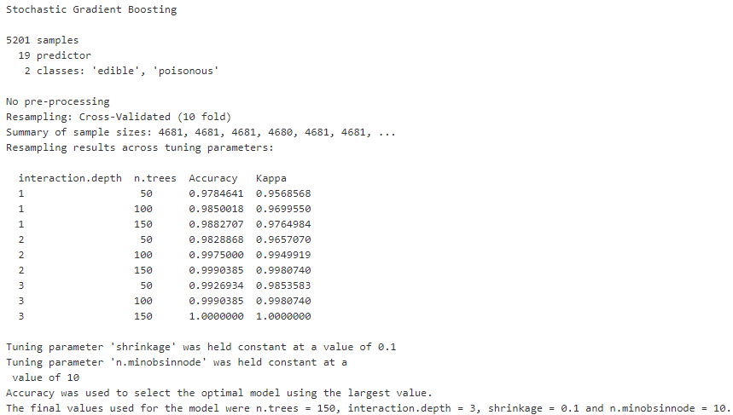
Training the Models on the Data
Gradient Boosting
Using an autotuned Gradient Boosting model found n.trees = 150, interaction.depth = 3, shrinkage = 0.1, n.minobsinnode = 10, to be the best performing model.

Slide 27
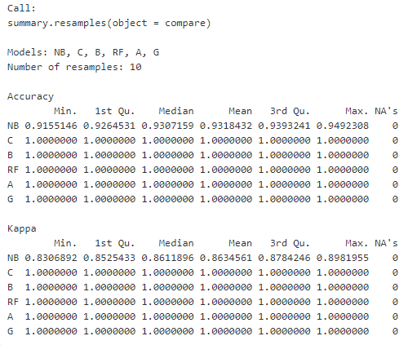
Training the Models on the Data
Comparing Models
Looking at all the results it appears every model performed perfectly except for Naïve Bayes. This is most likely due to some of the variables having quite a few levels especially the one’s concerned with color.

Slide 28

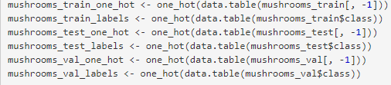
Training the Models on the Data
Neural Network
We first create a validation dataset for hyper-tuning parameters.
Next, we one-hot-encode all our variables since they are all categorical.

Slide 29
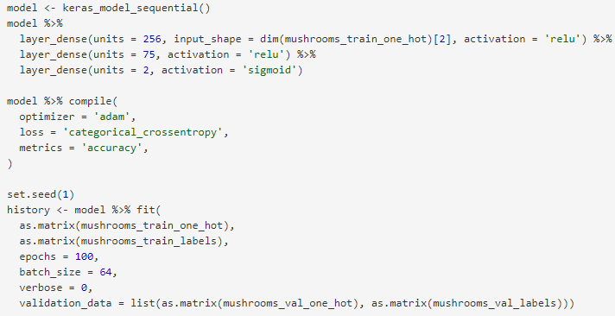
Training the Models on the Data
A basic neural network is created with a single hidden layer using Relu activation. The output is 2 nodes with a sigmoid activation.
We use Adam optimization with Categorical Cross-Entropy since we are one-hot-encoding our variables. We measure the accuracy as well.
The model is run 100 times with batch sizes of 64.
Basic Neural Network

Slide 30
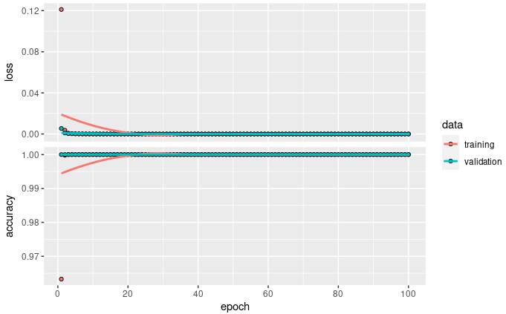
Training the Models on the Data
It doesn’t appear that we are overfitting the model. Training and validation basically stay together after 20 epochs.

Slide 31
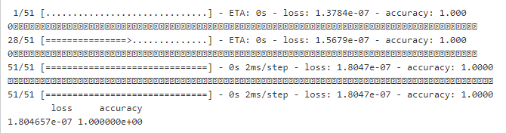
Evaluating the Neural Network
Our loss is an incredibly small number while accuracy is basically perfect.

Slide 32
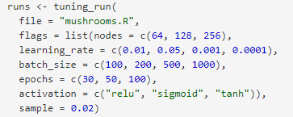
Improving the Model
Although our basic model performed well, we will tune some hyper-parameters to see if we can get it even better.

Slide 33
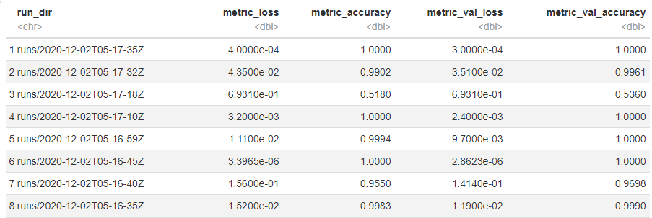
Improving the Model
We’ve got several runs that performed great. We will look at the 1st one and see what parameters were used.

Slide 34
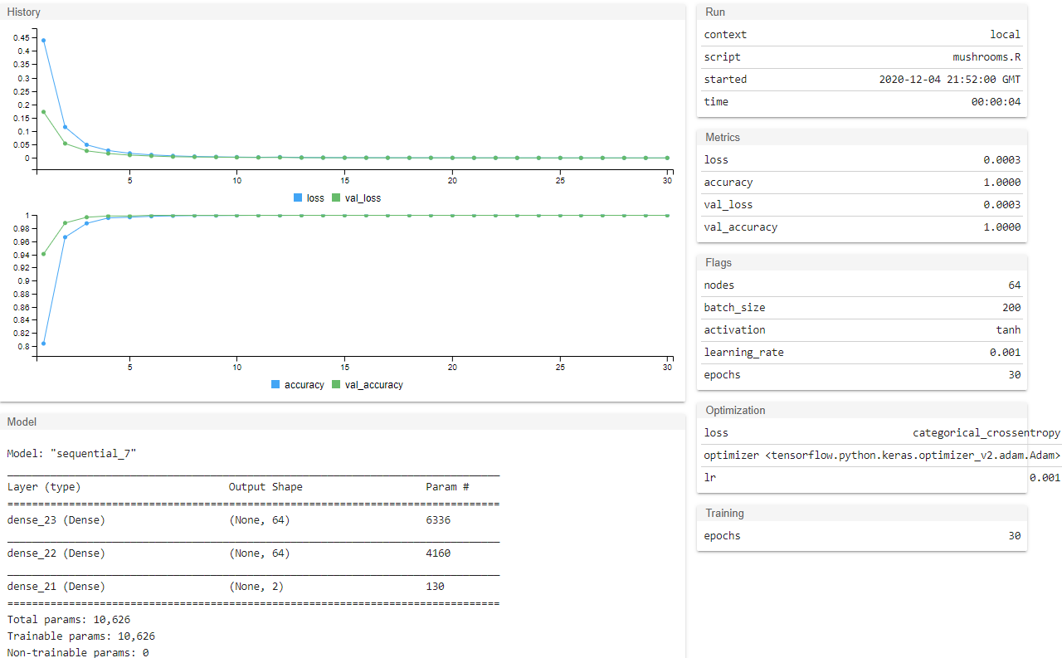

Slide 35
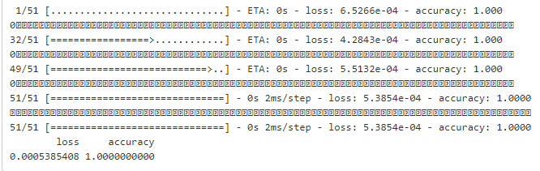
Improving the Model
Let’s combine our test and validation data and see how the model does.
A little worse on the loss but it’s basically negligible.

Slide 36
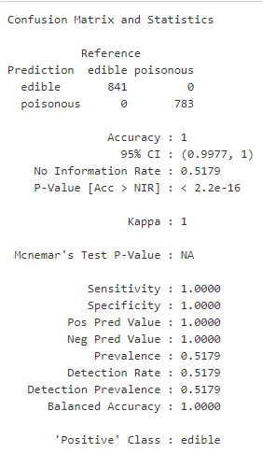
Evaluating the Best Model Performance
We get perfect classification using the updated model.
Compared to the other machine learning methods it performed the same, since it takes a lot more resources to run a neural network, in the future, it would be best to stick with a simpler model.

